Slide 1
Thank you Veterans of the Concordia R-II students and staff.

Slide 2
Dave Adams
Rank: Master Sergeant
Years of Service: 26
Deployments: Desert Storm 3 times, Kuwait twice, and Saudi Arabia
Related to Maddison and Kaylee Hall (CHS)

Slide 3
Roger Anderson
Rank: E-5
Years of Service: 4
Deployments: Vietnam (1970-1971)
Military Service: Served in Vietnam
Related to Jayden (CES student)

Slide 4
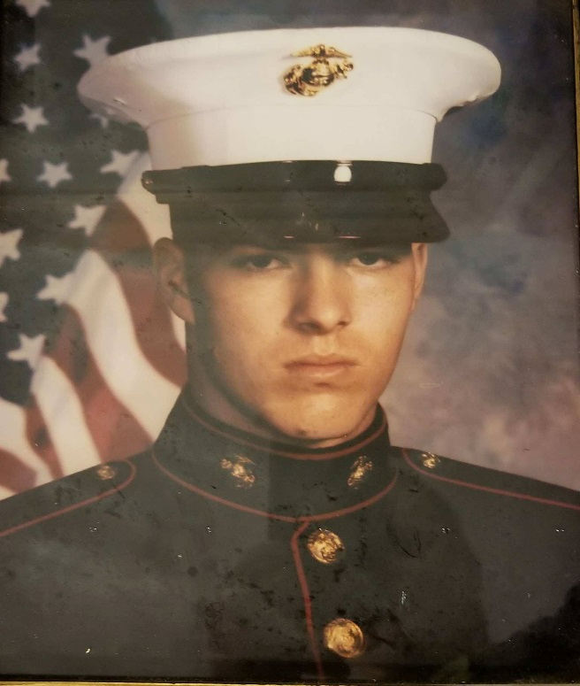
William Boles
Rank: 2311 (ammunition technician)
Years of Service: 5
Deployments: William was decorated with a meritorious unit commendation, and a second award expert on the rifle range. William was in the Marine Corps and was stationed at Camp Lejeune 2nd Supply battalion 2nd forward service support group
Related to Lilliana (CES), Kollen and Konner Akau (CHS)

Slide 5
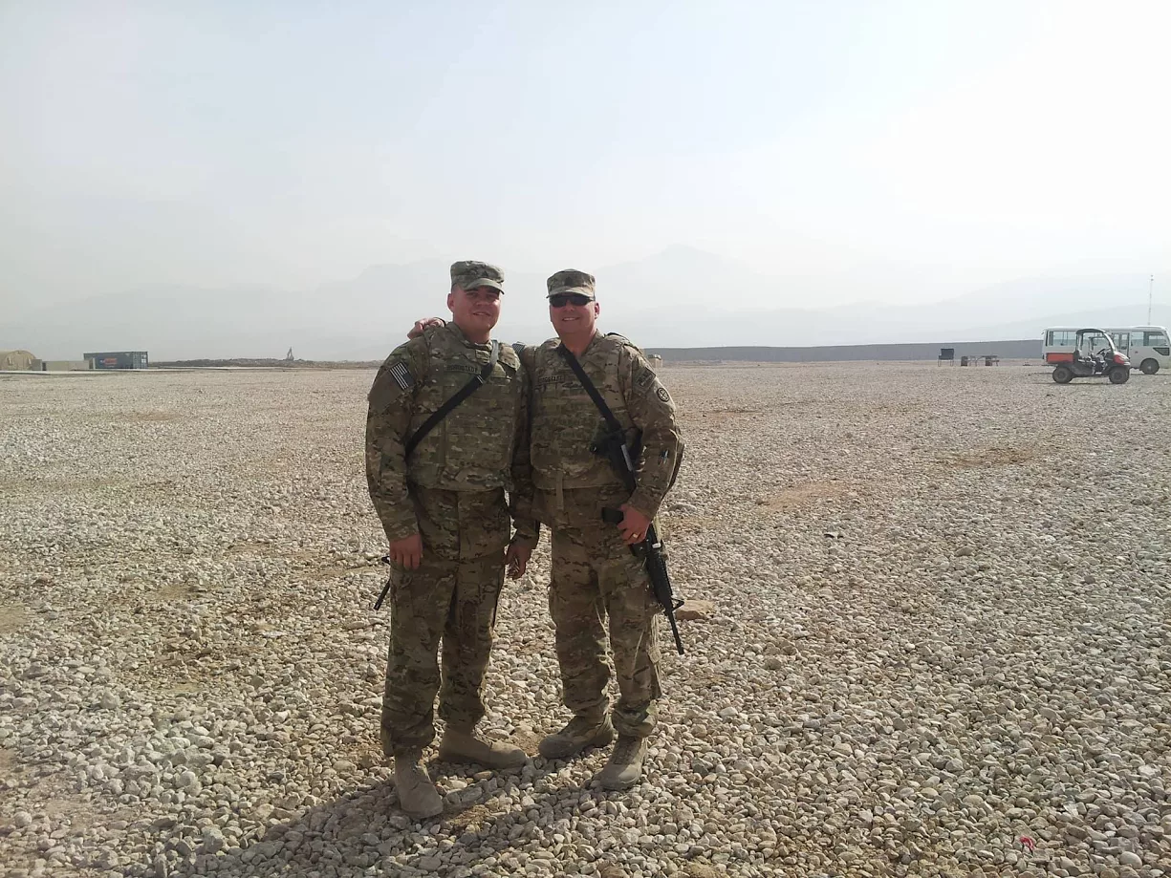
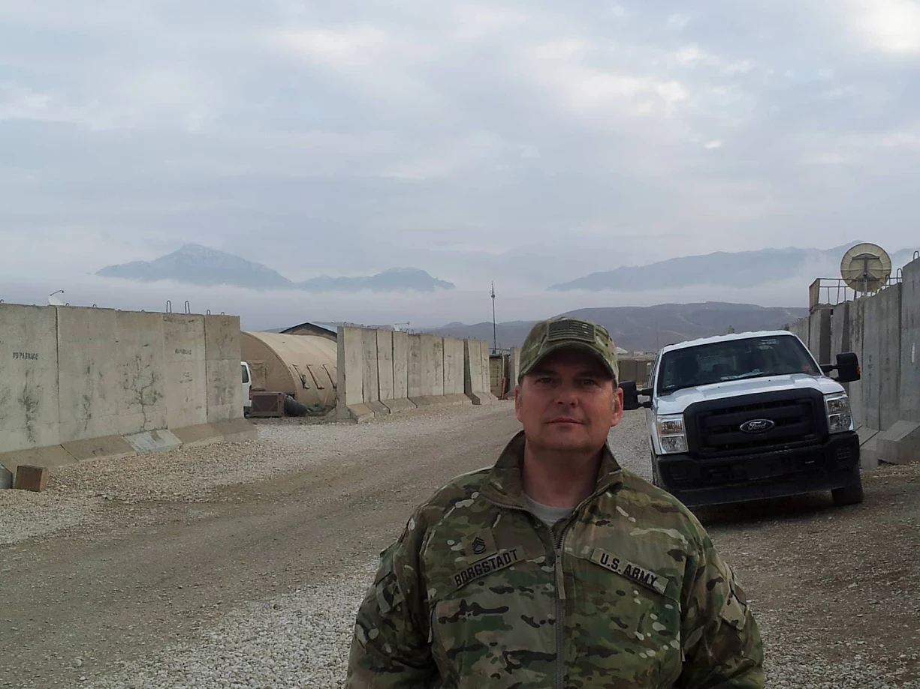
August Ed Borgstadt
Rank: E8 Master sergeant
Deployments: Germany 2001, Iraq 2004, Afghanistan 2013.
Military service: Marine Corps 1984-1989, Active
Duty National Guardsmen 1989-present. Positions held
are crew chief on A-4M, OH-58, AH-1, UG-1, AH-64,
UH-60 aircrafts, Platoon Sergeant, Current Operation
NCOIC for Blackhawk Helicopter Battalion. Awards are
Bronze Star, Air Medal, 9 Army Commendations
Medals, 4 Army Achievement Medals, Combat Action
Badge, and numerous lesser awards.
Grandpa to Lincoln (CES) & Hallie (CHS) Borgstadt

Slide 6
James Borgstadt
Rank: Sergeant
Years of Service: 15
Deployments: Desert Storm, Germany, Honduras, Kuwait
Related to Kaylee and Maddison Hall (CHS)

Slide 7
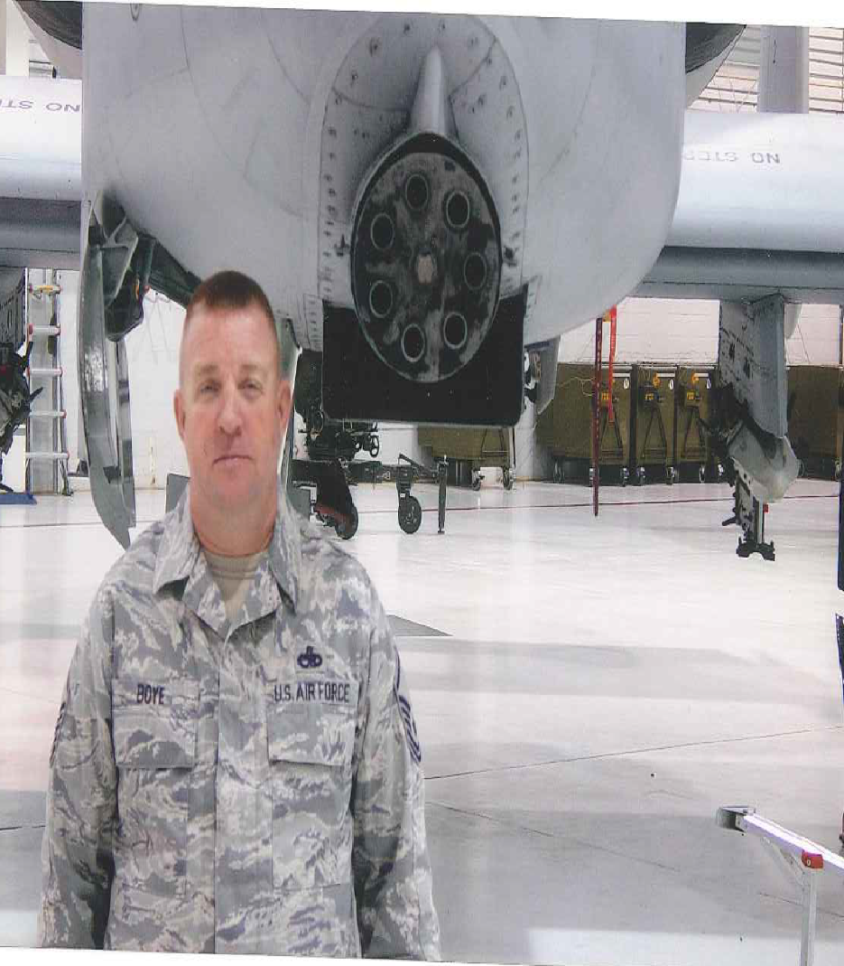
Robert Boye
Air Force – MSgt (retired)
Years of service: 26 Deployments – Al-Jaber Air Base, Kuwait – 1998; Incirlik Air Base, Turkey – 2000; Bagram AFB, Afghanistan – 2002; Suda Bay Crete: 2003; Bagram AFB, Afghanistan – 2006; Kandahar Afghanistan – 2011 & 2012 and numerous others
Military service: Joined Air Force in 1988, became a crew chief on the A-10 Warthog. Traveled the world for different operations to help fight terror groups
Father of CHS student Brooke Boye

Slide 8
Ben Bronkema
Army - Major
Years of service: 17
Deployments: 4 deployments to Afghanistan
Related to CHS students Micah and Gaige Neal

Slide 9
Shane Bryant
Marine Corps, Cpl
Years of service: 4 years, 9 months
Deployments: Japan, China, South Korea
Military service: 0341 Infantry
Uncle of Nichole and Cheyenne Estes

Slide 10
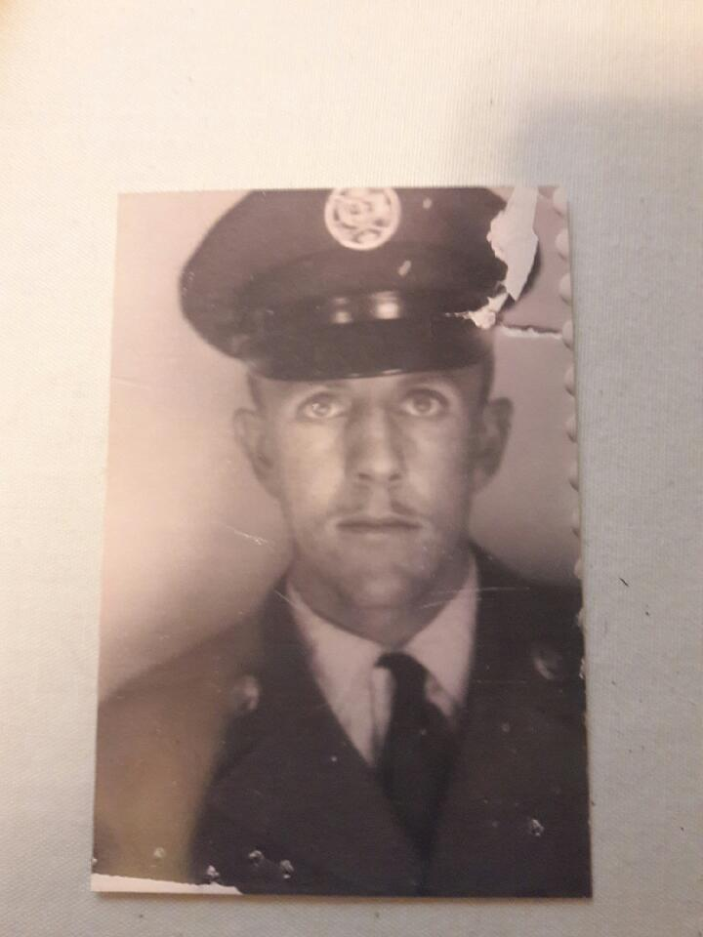
Clarence Creason
Rank: Private 3rd Class Airman
Years of Service: 8
Deployments: Korea
Military Service: In the Army from 1949-1950 where he received a service medal and a bronze star. He joined the Air Force in 1955 and then went into the reserves until 1965.
Related to CHS students Carson and Hunter Haley

Slide 11
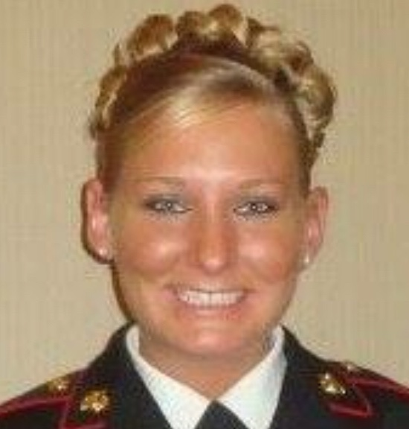
Amy Delatte
Sergeant, United States
Marine Corps
Years of service: 7
Deployments: Operation Iraqi Freedom, Operation Enduring Freedom
Military service: I joined the Marine Corps in August 2006 as a field radio operator. My first duty station was in Cherry Point, North Carolina where I deployed to Iraq in January 2009. My second duty station was in Camp Pendleton, California where I deployed to Afghanistan in February 2010. My last duty station was in Aurora, Colorado where I served on Inspector-Instructor duty. I was honorably discharged after 7 years and now reside in Thibodaux, Louisiana.
Aunt of Chasidy Cheney (CHS student)

Slide 12

Brady Delatte
Corporal, United States
Marine Corps
Years of service: 4
Deployments: Operation Iraqi Freedom, Operation Enduring Freedom
Military service: I joined the Marine Corps in January 2005 as an Aviation Communication Systems Technician. I was stationed in Cherry Point, North Carolina. I deployed to Iraq in January 2007 and again in January 2009. I was honorably discharged after 5 years and now reside in Thibodaux, Louisiana.
Uncle of Chasidy Cheney (CHS student)

Slide 13
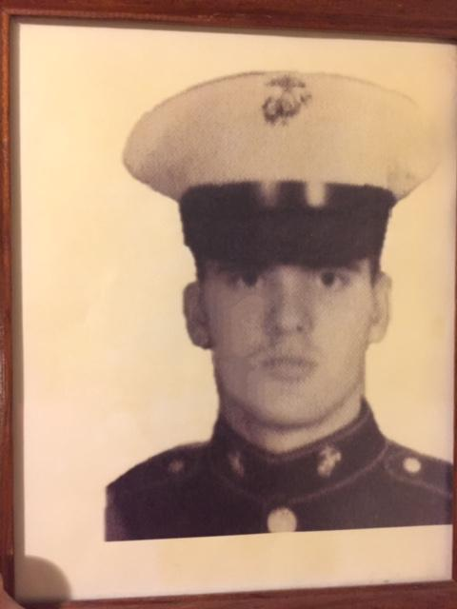
Mark A. Donahoo
USMC - Corporal.
Years of service: 4
Deployments: Overseas to Okinawa & Philippines
Military service: Artilleryman and Infantry
Related to CHS student Hunter Kearney

Slide 14
James Droege
Rank: SP4
Years of Service: 2
Deployments: October 1965-March 1967 in Germany
Military Service: Served with the 4th Armored Division Band
Grandfather to CHS student Piper Droege

Slide 15
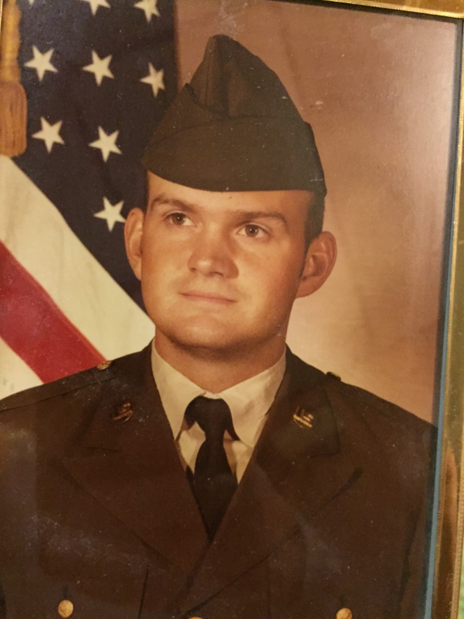
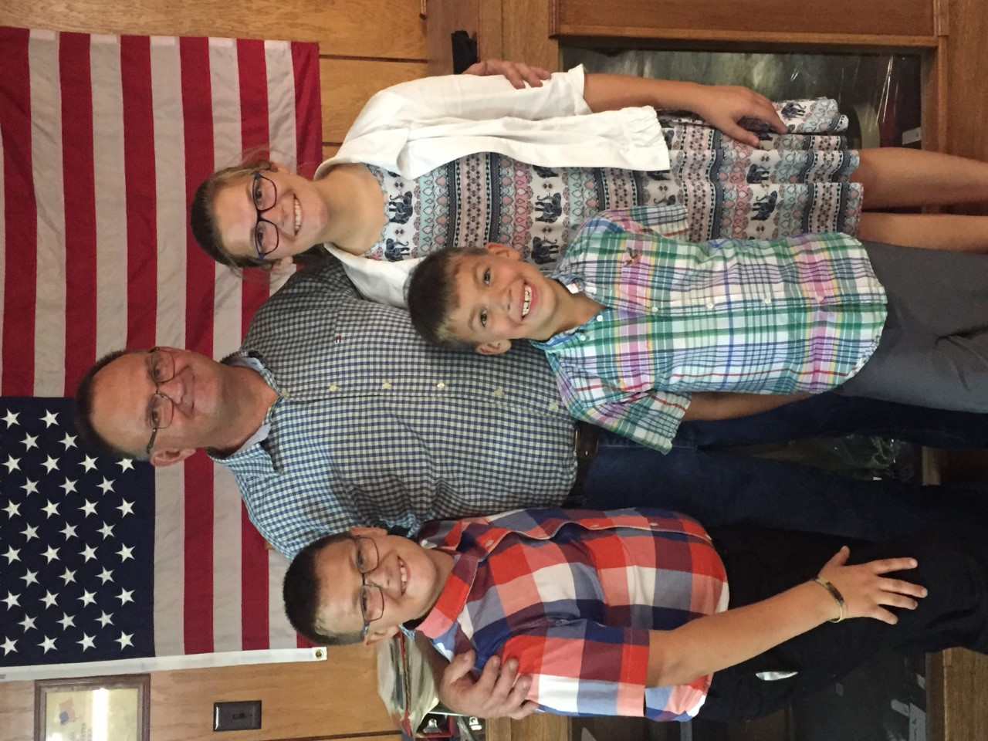
Chad Dyke
Rank: E-7 Staff Sergeant, US Army
Years of service– 12
Deployments– Trans Americas (Panama) twice Lyons Forces (Germany, Luxembourg, Belgium)
Military service– Started out small vehicle
and generator mechanic ended as
motor pool sergeant
Grandfather to student Owen Reid (CHS);
Father to CHS AD Amanda Reid, Great Uncle to CHS
student Kylie Canaday

Slide 16
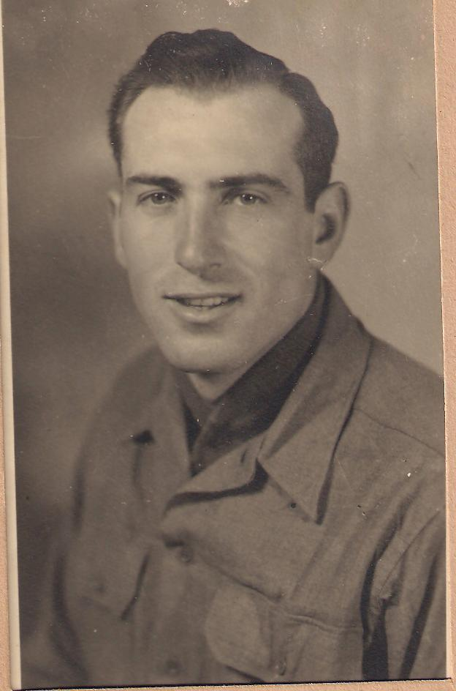
Gerald D. Ellis
Rank: E-4 Corporal Army
Years of Service: 4
Deployments: WW2 (Africa; Anzio, Italy)
Military service: Communications
Grandfather to Karen Hemme (former CHS teacher)

Slide 17
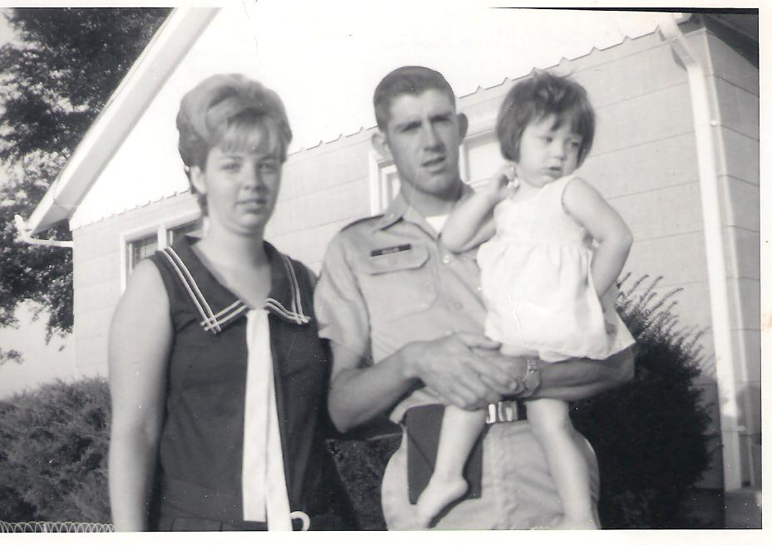
Roger D Ellis
Rank: E-7 Sgt. 1st Class in Army
Years of Service: 29 ½
Deployments: Vietnam (July 1970- July 1971)
Military service: Personnel Administration- retired March 1, 1999
Father to Karen Hemme (former CHS teacher)

Slide 18
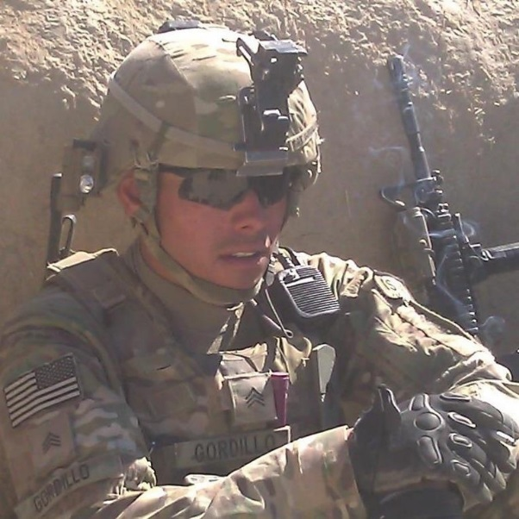
Ramon P. Gordillo
Sergeant E-5
Years of service: 9
Deployments: Operation Iraqi Freedom (2009-2010), Operation Enduring Freedom (Afghanistan 2012-2013), Operation Enduring Freedom (Horn of Africa 2014-2015)
Father of Rylie & Gabriel Gordillo (CHS students)

Slide 19
Timothy Haas
Army – Sgt. Bravo
Years of service: 7
Deployments: Three deployments to Afghanistan
Military service: Joined June 2008; honorably discharged Nov. 2015. Uncle Timmy was a combat engineer that would clear the route for other US soldiers to make it safely to their designation
Related to CHS students Hunter and Carson Haley

Slide 20
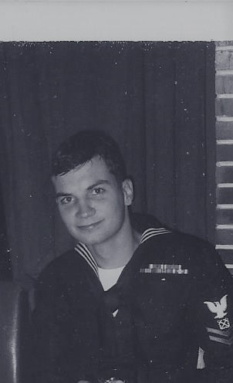
Stan Krzesinski
Rank: BM-2 (US Navy)
Years of Service: 4
Deployments: Vietnam 8/66- 8/67, Vietnam 11/67- 12/67, Mediterranean 11/68-3/69
Military service: USS Cook (APD- 130), USS Jamestown (agtr-3), River Assault Squadron 11, USS Ozark (MCS-2)
Grandpa of Kaelyn & Mia Krause (CES students)

Slide 21
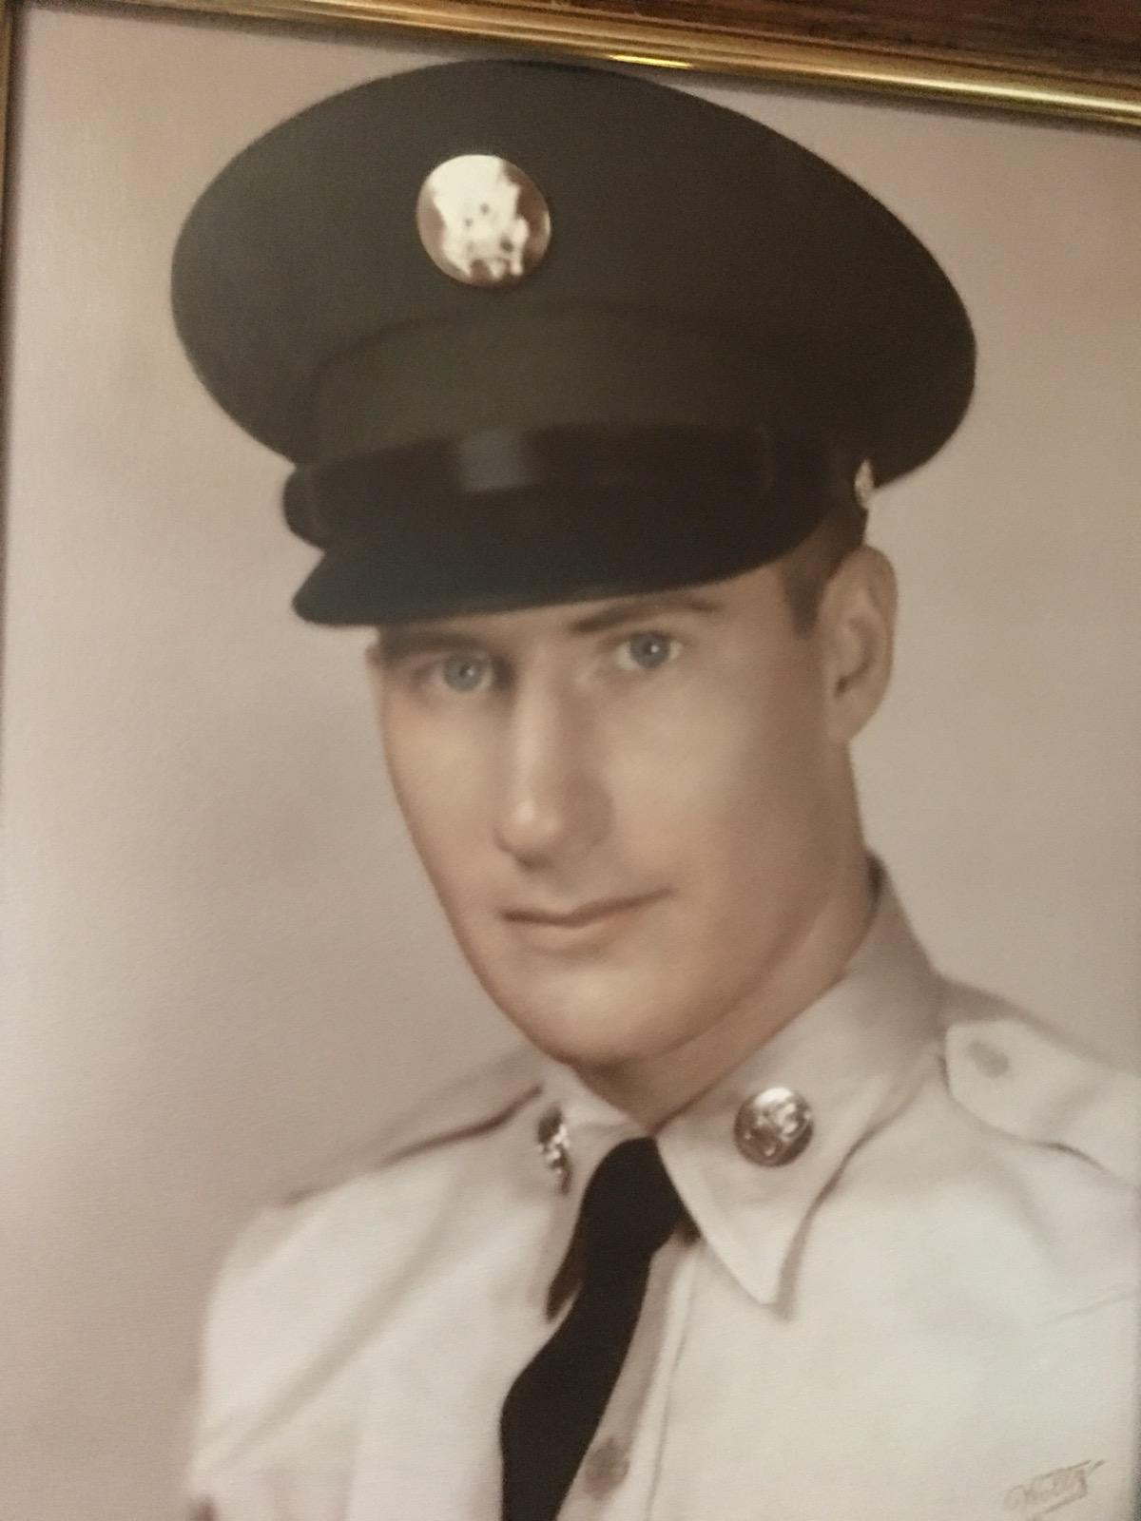
Randolph Lemmert
Rank: E-4 Specialist
Years of Service: 2 (1962-1964)
Deployments: Germany
Military Service: 78th Engineer Battalion,
Medic, Expert Marksman, Rifleman team
Father-in-law to Ms. Becca Lemmert

Slide 22
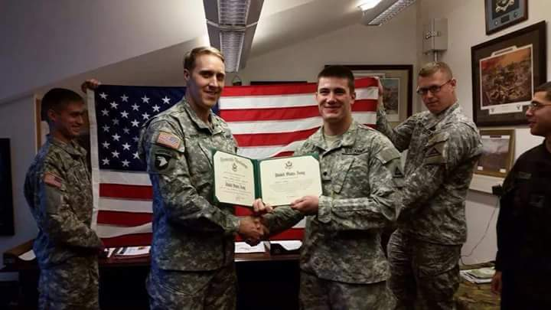
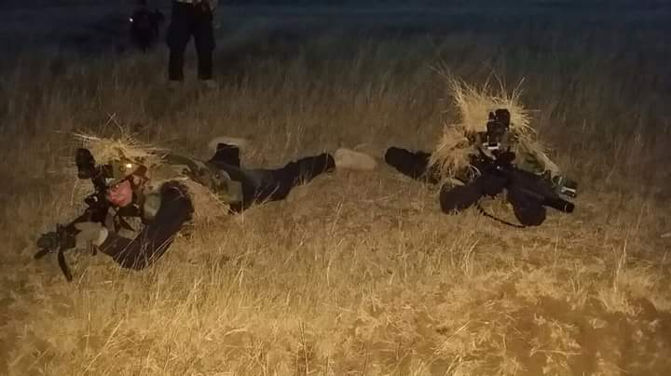
Jonathan Qureshi
Army - Corporal
Years of service: 5
Deployments: Iraq
Military service: Spent his first 3 years of service in Germany. In 2016 was deployed to Iraq.
Uncle to Lilliana, Konner and Kollen Akau

Slide 23
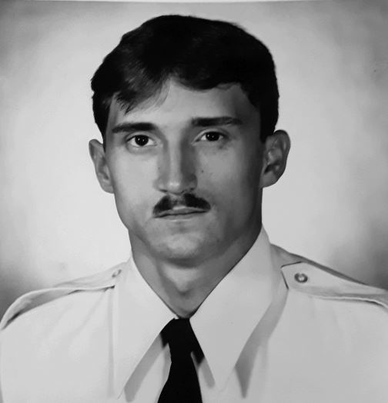
Randy Ratliff
Rank: E-5 (Staff Sergeant), US Air Force
Years of Service: 8 (1982-1990)
Deployments: multiple short deployments to Germany, Saudi Arabia, Grenada, Panama, Korea, Iceland
Military Service: U.S. Air Force, Security Police, Tactical Air Command Rapid Deployment Force
Grandfather to Gage Ratliff (CHS)

Slide 24
Randy Reynolds
Rank: Senior Master Sergeant (E-8)
Years of Service: 18
Military Service: 6 years active duty U.S. Air Force, 10 years in the Air National Guard, worked on the B-1 and B-2 bombers
Husband of Courtney Reynolds, Father of Dakota, Lexi and Max

Slide 25
Homer Roepe
Rank: Corporal
Years of Service: 1943-1946
Deployments: Philippines
Military Service: Combat engineer
Great-grandfather to Brody Roepe, Brianna Rolf, Malia Roepe (CHS)

Slide 26
Kevin Roepe
Rank: Captain, USMC
Years of Service: Active duty 2010-2014; Reserve duty 2016 - present
Deployments: Border Advisory Team, Afghanistan
Military Service: Logistics officer at Camp Pendleton, reserve officer for Korean Support Team in New Orleans
Cousin to Brody, Malia, Olivia, Brianna, and Erin (CES and CHS)

Slide 27
Ronald Roepe
Rank: Spec 4th Class Army
Years of Service: 1966-1968
Military Service: Explosive Ordnance Disposal (Bomb Squad), Ft. Benjamin, Harrison, IN
Great-Uncle to Brody & Malia Roepe, Brianna Rolf, Erin Heimsoth (CHS)

Slide 28
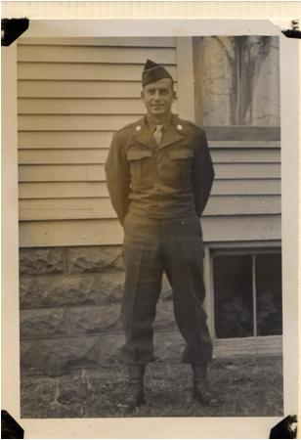
Robert G Sartin
Rank: Private in the Army
Years of Service: 1
Deployments: He was deployed to Korea but had to return home to work on the farm
Military service: Mechanic
Grandfather to Karen Hemme (former CHS teacher)

Slide 29
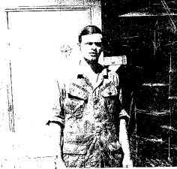
Michael Trautman
Rank: Petty Officer 2nd class (E-5), Naval Security Group
Years of Service: 1969-1973
Deployments: San Miguel, Republic of Philippines, 1972-73; DaNang, Republic of Vietnam, 1971-72
Military Service: Navy Achievement Medal, Combat Action Ribbon, Vietnam Campaign medal and Service medal
Instructor (and former principal) here at CHS!

Slide 30
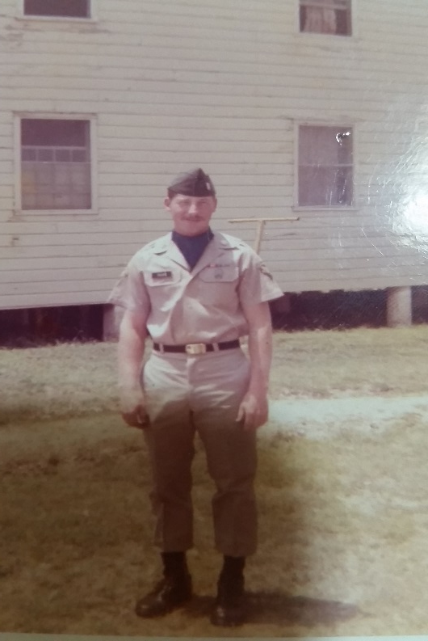
Jim Tyler
Rank: Specialist 5th Class
Years of Service: 3
Deployments: South Korea for 13 months (Sep. 1970-Oct. 1971)
Military Service: Enlisted under Army delayed program. He was sent to Korea as a helicopter radio mechanic in Sep. 1970
Grandfather to CHS students Taylor and Tyler Gard

Slide 31
Donny Fitzpatrick
Rank: Staff Sergeant
Years of Service: 9
Deployments: 4 deployments for a total of 2 years
Worked in special mission security for convoys
Related to CHS and CES students Cash, Cayse, Cheyenne, & Keaghan Fitzpatrick, Kinlee Riley

Slide 32
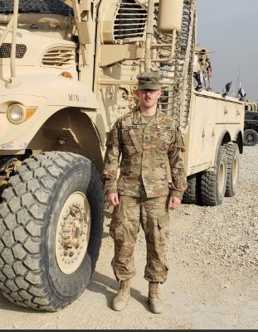
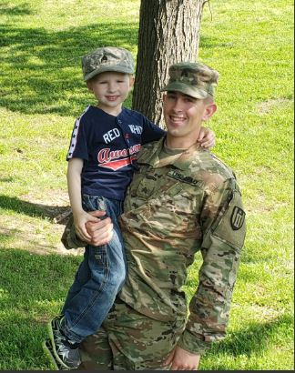
James Sherman
Rank: Sergeant in Army
Years of Service: 2014 - present
Military Service: He is part of the 348th Engineering Company out of Kansas City; was deployed to Afghanistan
Cousin of Janice Gudde

Slide 33
Dennis Payne
Rank: SSG
Years of Service: 20
Deployments: Operations Armored Falcon & Iraqi Freedom
USMC from 1990-1996; USMC Reserves from 1997-1998; MO Army National Guard from 2002-2015
Related to students Thadius (CES) and Kynleigh Abney (CHS)

Slide 34
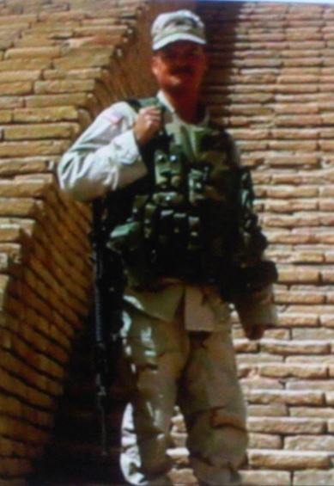
Scott Wallace
Rank: Sergeant First Class
Years of Service: 22
Deployments: South Korea, Wakenda, Operations Nobel Eagle, Enduring Freedom, Iraqi Freedom
Military Service: MO National Guard, combat engineer
Father of CES teacher Megan Butler

Slide 35
George Cook
Rank: Sergeant
Years of Service: 6
Deployments: Afghanistan
United State Marine Corps
Duty Station: Camp Lejeune and Okinawa
Uncle to Charlie, McKenna (CES) and Carter Cook (CHS)

Slide 36
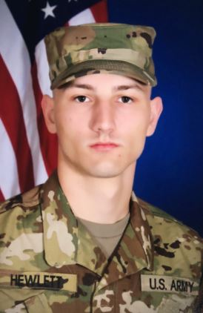
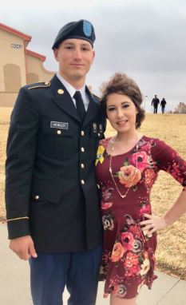
Garrett Hewlett
Rank: E-2
Years of service: 2018 - present
Military service: completed basic training at Fort Sill, OK; then AIT at Fort Lee, VA
Brother to CES teacher Megan Butler

Slide 37
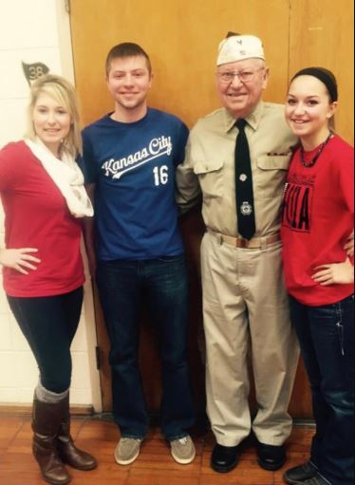
Karl Wenzel
Years of Service: 1954-1956
Deployments: Stationed in France, served in Korean War
Military Service: served in the motor pool and managed the officer’s club
Grandfather of CES teacher Megan Butler

Slide 38
David Wray
Rank: MSGT
Years of service: 20
Deployments: Thailand (twice), Germany, Africa
Military service: Service superintendent, Service police
Related to Liam King (CHS student)

Slide 39
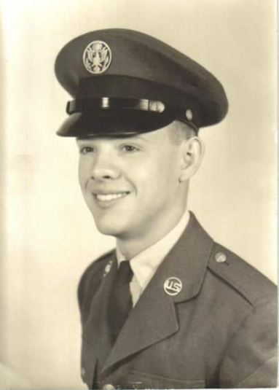
Larry Hardison
Rank: Sergeant
Years of Service: 1963-1967
Deployments: Vietnam, 1966-1967
Military service: Lackland AFB, San Antonio, TX; Lowry AFB, Denver, CO (trained for Intelligence Operation Specialist); Richards Gebaur AFB, Belton, MO; Saigon, Vietnam (Covert Intelligence Operations)
Grandparent of CHS student Aneira Jones

Slide 40
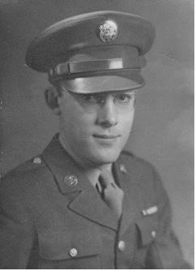
Lloyd Beissenherz
Rank: Master Sergeant, US Army
Years of Service: 1941-1945, World War II
Deployments: Normandy, Northern France, Germany
Military service: Investigator for the Counter Intelligence Corps; BAR Marksman & Pistol Marksman; awarded 3 Bronze Stars & Good Conduct Medal, among others
Great-Grandfather of CHS students Eli & Eden Beissenherz

Slide 41
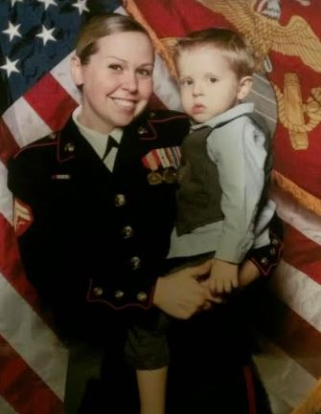
Chelsea Frerking
Rank: Sergeant
5 years of Service
Deployments: Operation Enduring Freedom in Afghanistan
Military service: Served as Field Radio Operator, deployed with Navy Medical Unit when in Afghanistan
Mother of CHS student Bentlee Reed and August Frerking (CES)

Slide 42
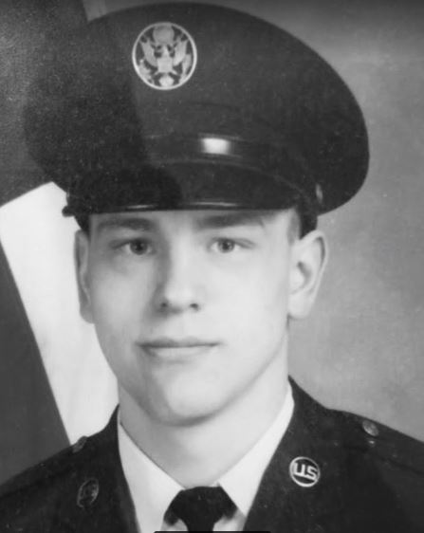
Dan Gilio
Rank: SSgt/E-5
10 years of Service
Military service: Stationed at Whiteman Air Force Base as Security Police; Served during the Cold War and Desert Shield/Storm; worked on the Rail Garrison Project
Grandfather of students Gabby, Anja, and Danni Oberdorfer

Slide 43
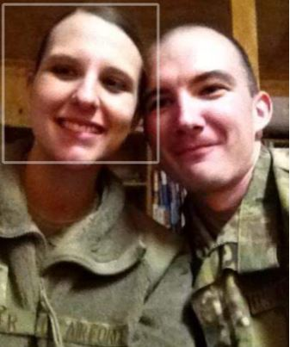
Ian Oberdorfer
Rank: E-4/SrA
8 years of Service
Deployments: Afghanistan, Saudi Arabia
Military service: Worked on the A-10 aircraft; stationed in Arizona, Germany, and California
Father of students Gabby, Anja, and Danni Oberdorfer

Slide 44
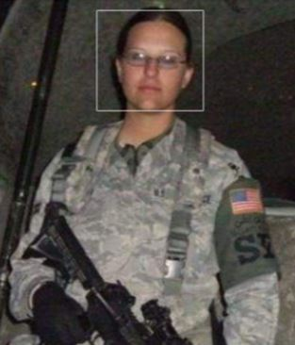
Kasidy Oberdorfer
Rank: E-5/SSgt
9 years of Service
Deployments: Afghanistan, Qatar
Military service: Worked as Security Forces and Airman Dormitory Leader; stationed in Arizona and Germany
Mother of students Gabby, Anja, and Danni Oberdorfer

Slide 45
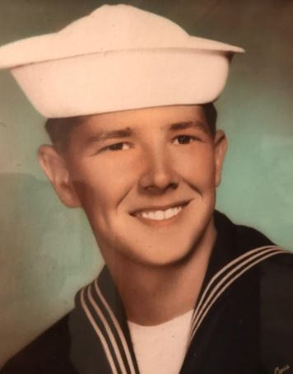
Roy Eckhoff
Rank: Petty Officer, 2nd Class
9 years of service
Deployments: 3 Mediterranean Sea Cruises, 1 Pacific Ocean Cruise, Vietnam West-Pac Cruise
Military service: Electronic Technician, worked on navigation and weapons systems, stationed in Florida and California, taught Electronic Theory
Grandfather of CES student Tilly Eckhoff

Slide 46
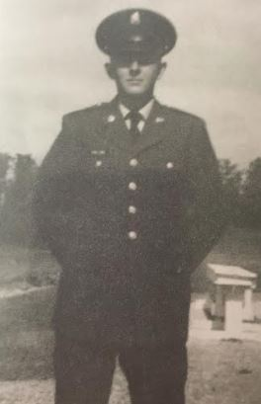
Sophus Collins
Rank: Specialist E4
2 years of service
Deployments: Vietnam
Military service: Combat Engineer
Great-Uncle of Gage Kueck

Slide 47
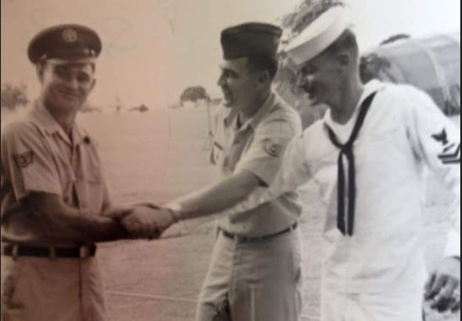
Charles Tharp
In the photo, Left to Right: Robert Tharp (uncle) Army, Charles Tharp (dad) USAF, and Jim Tharp (uncle) Navy while in Vietnam
Rank: MSGT
20 years of service in Air Force
Deployments: 3 overseas (Vietnam, Spain, Germany)
Military service: worked in TMO (stationed in California & North Dakota)
Relative of CES student Arraeya Utterback

Slide 48
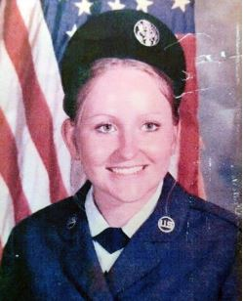
Anita McCurdy
Rank: E-5 Staff Sgt
13 years of service (1979-1992)
Deployments: 1 overseas
Military service: Space Command, Peterson AFB, Colorado (1983-1987); Strategic Air Command, Comisco, Sicily (1987); Whiteman AFB, Missouri (1981-1983 & 1987-1992)
Grandma of CES/CHS students: Malia Roepe; Emma & Rawnie McCurdy; Kollen, Lilli, & Konner Akau; Kai & Mason Ballenger

Slide 49
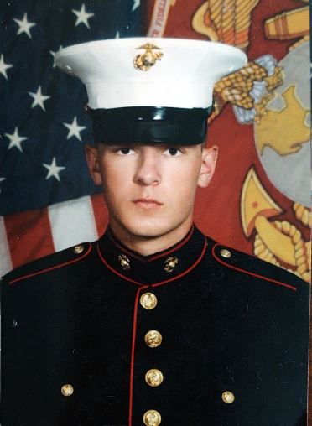
Justin L. Williams
Rank: Corporal
4 years of service
Deployments: 2020 USS Bataan Amphibious; 7 months to Europe, Middle East, and Africa
Military service: Military motor transport operator; served as security team leader and logistics planner
Uncle to students Zell, Avery, and Zirah Hinck

Slide 50
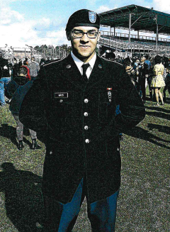
Christopher Mays
Rank: E-5
3 years of service
Deployments: Kabul, Afghanistan
Military service: Stationed at Ft. Bragg in North Carolina; in the 82nd Airborne division & serves on the Instant Response Force
Son of CHS admin assistant Debra Johnson

Slide 51
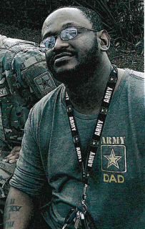
Wilbert (EJ) Johnson
Rank: E-4
6 years of service
Deployments: Taji, Baghdad, Fallujah, Najahaf in Iraq
Military service: Stationed at Ft. Benning and Ft. Hood; Infantry soldier; served 3 tours in Iraq driving Bradley tank
Husband to CHS admin assistant Debra Johnson

Slide 52
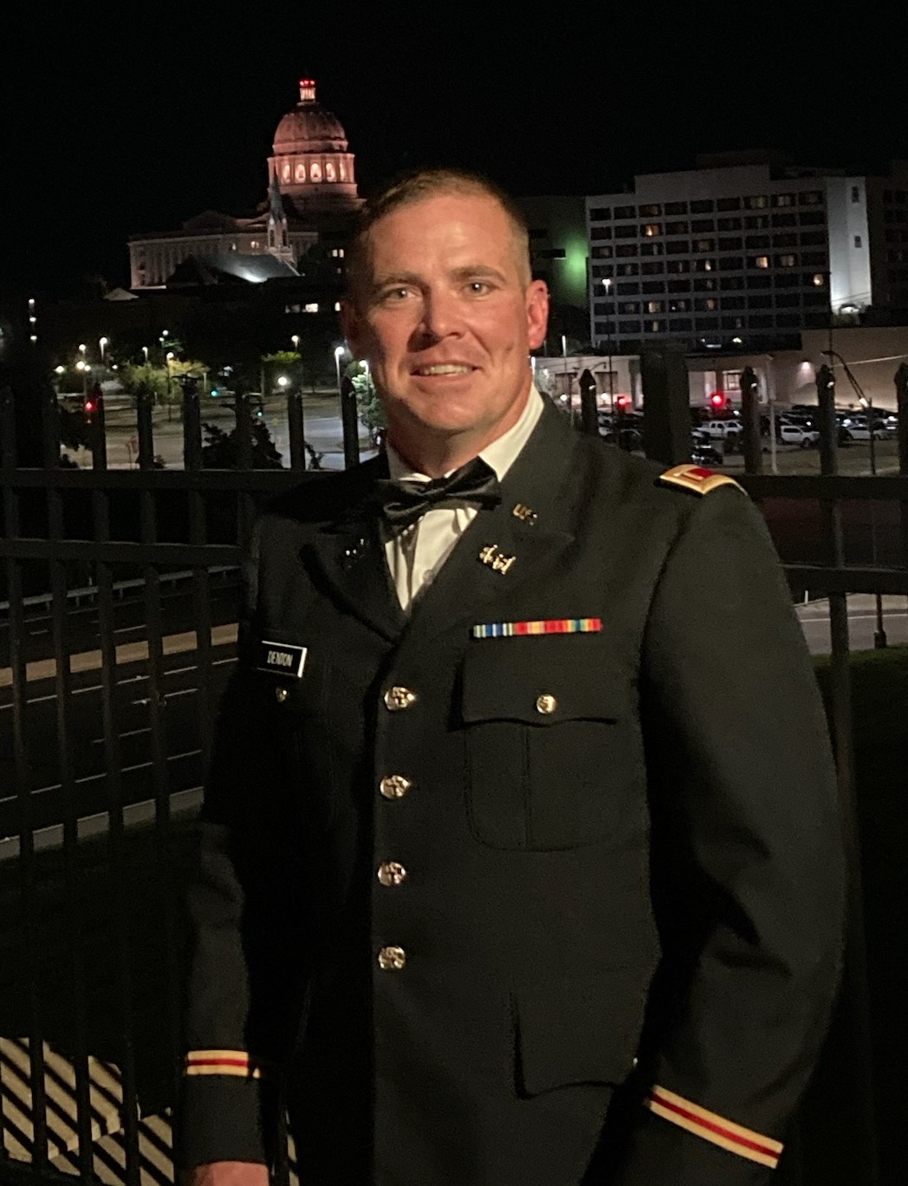
Steve Denton
Rank: 2LT
Years of service: 2019 - present
Military service:
35th Infantry Division (Lexington),
1135th Engineer Company (Richmond)
CHS Physical Education Instructor & head Track & Field Coach

Slide 53
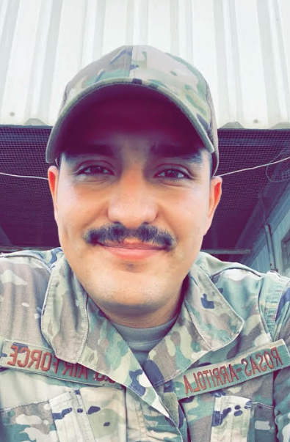
Juan Rosas-Arritola
Rank: Staff Sergeant
9 years of service
Deployments: Afghanistan, Kuwait, Jordan, & United Arab Emirates
Military service: Structural engineer in the US Air Force; stationed in Guam, California, S. Korea and Whiteman AFB
Cousin to CES students Brantley & Brooklyn Shearer

Slide 54
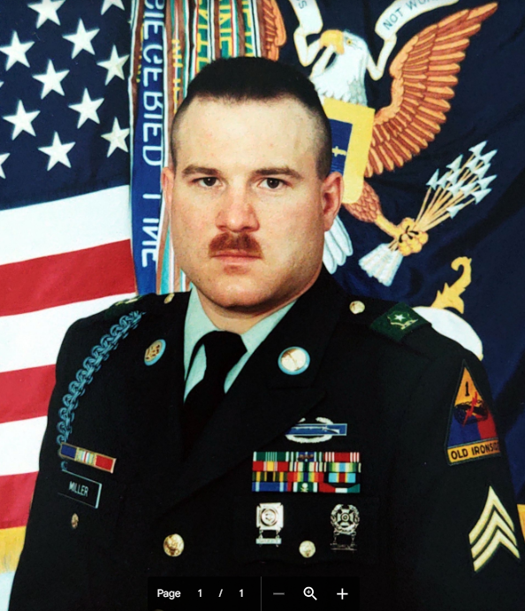
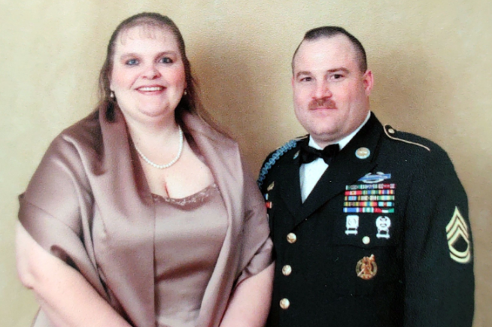
Kevin Miller
Rank: SFC (Retired)
21 years of service
Deployments: Iraq, Korea, Germany, Bosnia
Military service: served in many capacities in many countries - Infantryman, Gunner, Safety Officer; earned many medals
Grandpa of CES student Finn Walkenshaw

Slide 55
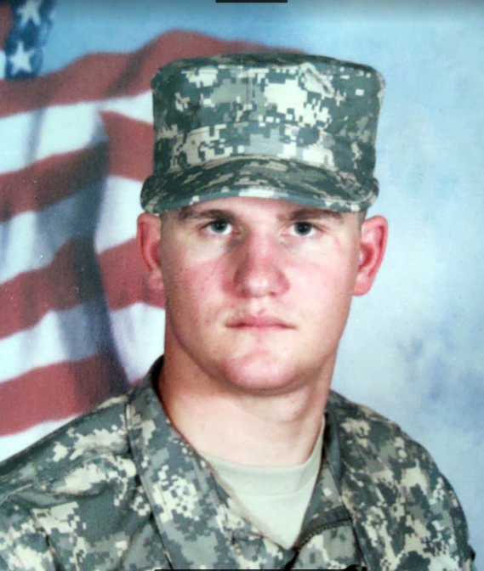
Zane Westfall
Rank: 1 Lt.
8 years of service
Military service: Military Police Officer and commissioned as an Artillery Officer; commanded a platoon on the Paladin & then the HIMARS system
Father to CES students Kaidyn & Macy Westfall

Slide 56
John DePee
Rank: E-5
3 years of service
Deployments: Vietnam (1970-1971), Japan (1970)
Military service: Worked on Army helicopters & aircraft; specialized in prop & tail rotors
Grandfather of CES student Joseph Morrison

Slide 57
John Edward Estes
Rank: Sergeant
4 years of service
Deployments: Vietnam, Japan
Military service: Stationed in Okinawa, Japan - when the plane stopped to refuel, he was picked to go to Vietnam
Grandfather of CHS student Avriella Estes

Slide 58
Monroe Kirchhoff
Rank: Sgt
Deployments: Germany
Military service: Drafted into World War II in Germany
Great-grandfather of CHS students Ben Kirchhoff & Luella Kirchhoff

Slide 59
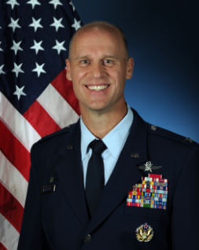
Steven Anderson
Rank: Colonel, USAF
29 years of service
Deployments: Operations Northern Watch, Southern Watch, Iraqi Freedom, Enduring Freedom
Military service: Commander of the 688th Cyberspace Wing, TX (final duty before retiring) after many other assignments
Great Uncle to CES student Bennett Werths

Slide 60
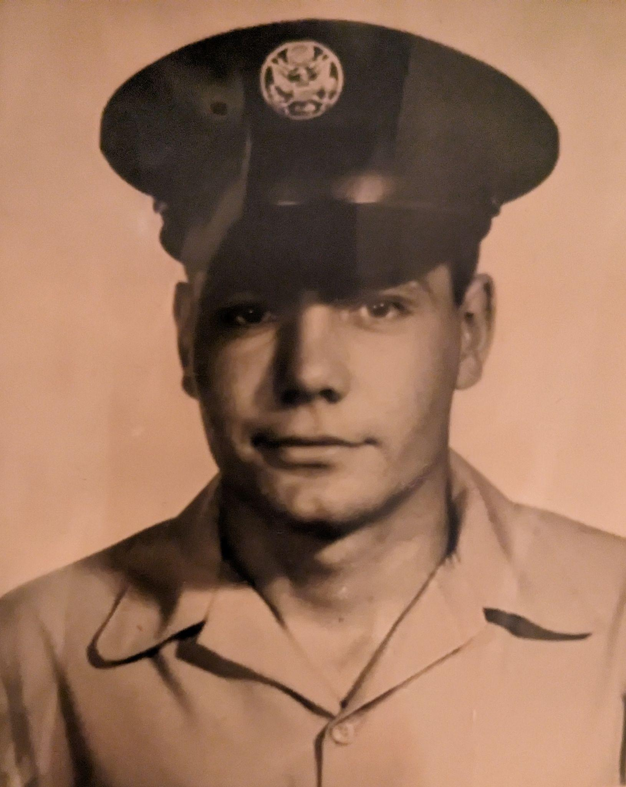
Kenton Mueller
Rank: Staff Sergeant, USAF
5 years of service, 1972-1977
Deployments: Germany
Military service: He joined the Air Force after attending college. He was honorably discharged on May 16, 1977
Grandfather to CHS students Ayla and Ashton Wilt

Slide 61
Jacob Borgstadt
Rank: SFC
17 years of service
Deployments: OEF (2013-2014) Afghanistan; OIR (2018-2019) Iraq
Military service: Worked at various bases on Apache & Blackhawk helicopter repairs; currently serving as Platoon Sergeant with Bco 1-135th Assault Helicopter Battalion
Father to CHS/CES students Hallie & Lincoln Borgstadt

Slide 62
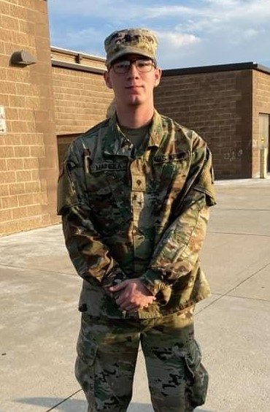
Blake Meineka
Rank: Sergeant
9 years of service
Deployments: 2021-22 deployed to Arizona/Mexico border
Military service: Training at Fort Leonard Wood & Fort Lee, currently a diesel mechanic with the KS Army Nat’l Guard
Uncle to CES students Brantley & Brooklyn Shearer and Mason Howard

Slide 63
William Crowell
Rank: Sgt
Years of service: 10
Deployments: 2 years deployed during Operation Iraqi Freedom and 1 year deployed during Operation New Dawn
Father to CHS student Alyssa Cook

Slide 64
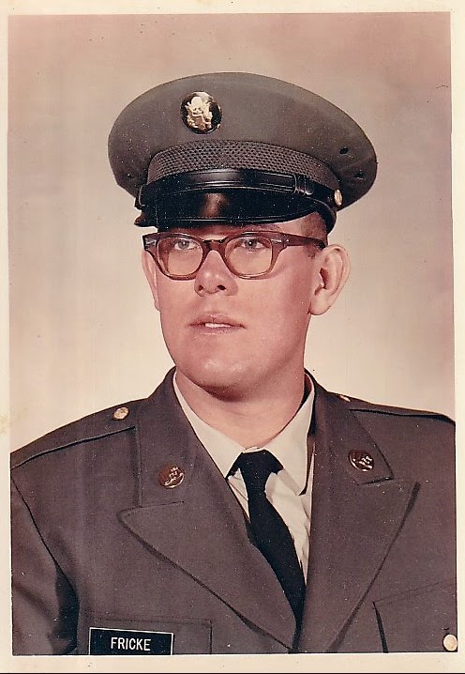
Richard Fricke
Rank: SP4 E-4
Years of service: 1969-1975
Deployments: Vietnam
Military service: Served in Vietnam, then returned to Fort Riley, KS. Served with B Co. Bn 10th 1st Infantry Div; recipient of many medals (Nat’l Defense Service Medal, Air Medal, etc.)
Grandpa to CES teacher Hannah Bargfrede

Slide 65
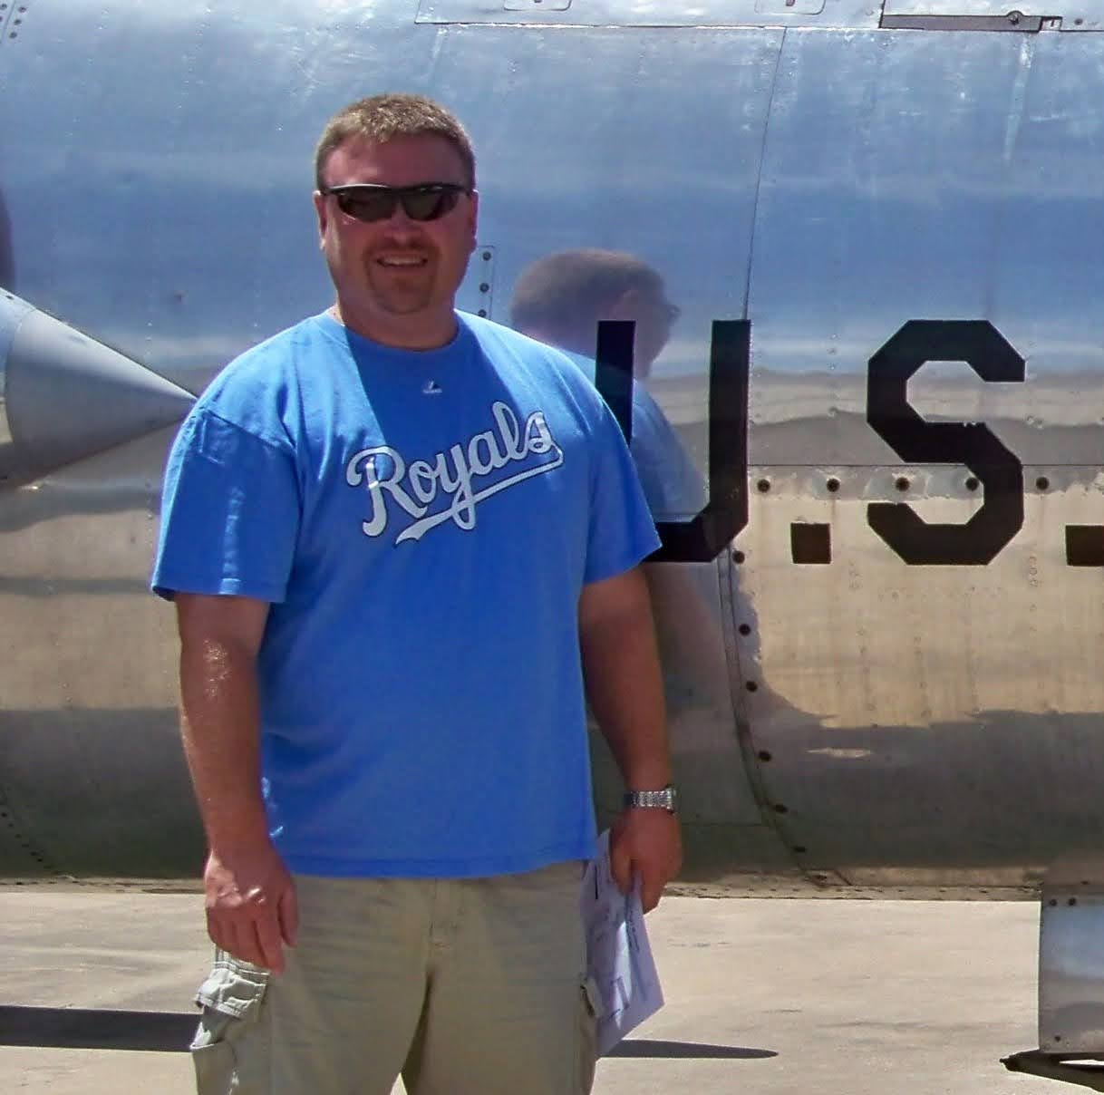
Tom Legate
Rank: Technical Sergeant E-6, US Air Force
Years of service: 1991-1997
Deployments: Aviano, Italy to assist with Operation Deny Flight
Military service: A-10 Aircraft Mechanic and Crew Chief, stationed at Richards-Gebaur and later Whiteman AFB
Husband to CHS teacher Amy Legate

Slide 66
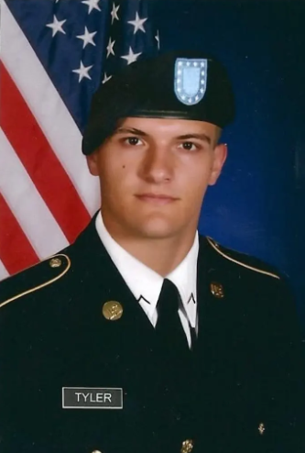
Jordan Tyler
Rank: E-4 Specialist, US Army
6 years of service
served as combat engineer with the 1135th Engineer Co.
Current CHS business teacher and head varsity football coach; father to CES student Trae Tyler, husband to CES staff Kayla Tyler, and son to CHS staff Cody Tyler

Slide 67

Julio F. Colón “Chico”
Rank: Master Sergeant, US Air Force
Years of service: 1957-1977
Deployments: Greenland, Panama Canal Zone, Thailand
Military service: He served stateside in Waco, TX; Alamogordo, NM; Selma, AL; and Belton, MO
Great-Grandpa to CES students Seattle & Shepherd Davis

Slide 68

Gene McCaulley
Rank: E-5 Sergeant
5 years of service
Grandfather to CES students Wesley & Cora Gieselman, and CHS student Maya Boyle

Slide 69

Shawn Blemings, Jr.
Rank: E-5
Years of service: 6
Military Service: Civil Engineer electrician in the Air Force, stationed at Whiteman Air Force Base
Father to CHS student Kaydin Blemings

Slide 70
John Need
US Navy, Petty Officer 3rd Class
Served in Vietnam
Deployed 1967-1970
Father to ELL teacher Sarah McDaniel

Slide 71

Doug Wahn
Rank: E-4 Corporal, US Marine Corps
Years of service: 1969-1975
Deployments: Vietnam
Military service: Radio man with 1st Battalion, 5th
Marines and 2nd Battalion, 1st Marines. Later
assigned to sniper platoon and 81 mortar platoon.
Grandpa to CES student Arianna Wahn

Slide 72

Harland Mieser
Rank: E-4 Corporal
Years of service: 6
Military service: Army Reserve summer camps at Camp McCoy, WI and Camp Perry, OH
Grandpa to CES student Arianna Wahn

Slide 73
Donald J. Myers
Rank: E5, Army National Guard
13.5 years of service
Grandfather to CES student Kayelee Reynolds

Slide 74

Friend L. Reel
Rank: E-5 Sergeant
served in World War II
22 years in US Navy
Related to Chelle Sisk, CES teacher

Slide 75

Alan Daly
Rank: Technical Sergeant
served for 13 years in US Air Force
Jobs included: Security Forces, Combat Arms, and Military Training Leader
Brother-in-law to Laura Oliveros, CHS staff

Slide 76


